Slide 1

Fungsi dan Array

Slide 2
Fungsi
Fungsi adalah blok pernyataan yang dapat digunakan berulang kali dalam suatu program.
Sebuah fungsi tidak akan dijalankan secara otomatis saat halaman dimuat.
Suatu fungsi akan dieksekusi dengan memanggil nama fungsi tersebut.
Jenis fungsi:
  User Defined Functions
  Built-in Functions

Slide 3
User Defined Functions
Syntax
    function functionName() {
    code to be executed;
    }
Contoh:
  <?php
  function pesan() {
  echo "Hello world!";
  }
  pesan(); // pemanggilan fungsi
  ?>

Slide 4
pass-by-value
  <?php
  function tambah(int $x, int $y) {
  $a=$a+10;
  $z = $x + $y;
  return $z;
  }
  $a=10;
  $b=5;
  echo "5 + 10 = " . tambah(5, 10) . "<br>";
  echo "7 + 13 = " . tambah(7, 13) . "<br>";
  echo “$a + $b = " . tambah($a, $b);
  echo $a;
  ?>

Slide 5
pass-by-reference
  <?php
  function tambah(int $x, int $y) {
  $a=$a+10;
  $z = $x + $y;
  return $z;
  }
  $a=10;
  $b=5;
  echo "5 + 10 = " . tambah(5, 10) . "<br>";
  echo "7 + 13 = " . tambah(7, 13) . "<br>";
  echo “$a + $b = " . tambah($a, $b);
  echo $a;
  ?>

Slide 6
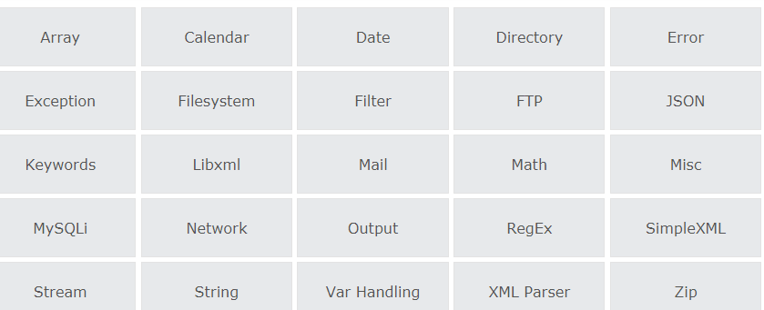
Built-in Functions
PHP has more than 1000 built-in function

Slide 7
String
strlen() - Return the Length of a String
str_word_count() - Count Words in a String
strrev() - Reverse a String
strpos() - Search For a Text Within a String
str_replace() - Replace Text Within a String

Slide 8
String
strlen() - Return the Length of a String
str_word_count() - Count Words in a String
strrev() - Reverse a String
strpos() - Search For a Text Within a String
str_replace() - Replace Text Within a String
<?php
echo strlen("Hello world!"); // outputs 12
echo str_word_count("Hello world!"); // outputs 2
echo strrev("Hello world!"); // outputs !dlrow olleH
echo strpos("Hello world!", "world"); // outputs 6
echo str_replace("world", "Dolly", "Hello world!"); // outputs Hello Dolly!
?>

Slide 9
Math
PHP has a set of math functions that allows you to perform mathematical tasks on numbers.
    <?php
    echo(abs(-6.7)); // returns 6.7
    echo(sqrt(64)); // returns 8
    echo(round(0.60)); // returns 1
    echo(round(0.49)); // returns 0
    echo(rand());
    echo(rand(10, 100));
    ?>

Slide 10
Date
date(format,timestamp)
parameter format:
  d - Represents the day of the month (01 to 31)
  m - Represents a month (01 to 12)
  Y - Represents a year (in four digits)
  l (lowercase 'L') - Represents the day of the week
  H - 24-hour format of an hour (00 to 23)
  h - 12-hour format of an hour with leading zeros (01 to 12)
  i - Minutes with leading zeros (00 to 59)
  s - Seconds with leading zeros (00 to 59)
  a - Lowercase Ante meridiem and Post meridiem (am or pm)

Slide 11
Contoh Tanggal & Waktu
  <!DOCTYPE html>
  <html>
  <body>
  <?php
  echo "Today is " . date("Y/m/d") . "<br>";
  echo "Today is " . date("Y.m.d") . "<br>";
  echo "Today is " . date("Y-m-d") . "<br>";
  echo "Today is " . date("l");
  ?>
  </body>
  </html>
  <!DOCTYPE html>
  <html>
  <body>
  <?php
  echo "The time is " . date("h:i:sa");
  ?>
  </body>
  </html>

Slide 12
Date From a String
  <!DOCTYPE html>
  <html>
  <body>
  <?php
  $dd=strtotime("10:30pm April 15 2014");
  echo "Created date is " . date("Y-m-d h:i:sa", $dd);
  $d=strtotime("tomorrow");
  echo date("Y-m-d h:i:sa", $d) . "<br>";
  $d=strtotime("next Saturday");
  echo date("Y-m-d h:i:sa", $d) . "<br>";
  $d=strtotime("+3 Months");
  echo date("Y-m-d h:i:sa", $d) . "<br>";
  ?>
  </body>
  </html>

Slide 13
Array
An array is a special variable, which can hold more than one value at a time.
types of arrays:
  Indexed arrays - Arrays with a numeric index
  Associative arrays - Arrays with named keys
  Multidimensional arrays - Arrays containing one or more arrays

Slide 14
Indexed Array
<!DOCTYPE html>
<html>
<body>
<?php
$cars = array("Volvo", "BMW", "Toyota");
echo "I like " . $cars[1] . " and " . $cars[2] . ".";
$arrlength = count($cars);
for($x = 0; $x < $arrlength; $x++) {
echo $cars[$x];
echo "<br>";
}
?>
</body>
</html>

Slide 15
Associative Arrays
<!DOCTYPE html>
<html>
<body>
<?php
$age = array("Peter"=>"35", "Ben"=>"37", "Joe"=>"43");
foreach($age as $x => $x_value) {
echo "Key=" . $x . ", Value=" . $x_value;
echo "<br>";
}
?>
</body>
</html>

Slide 16
Two-dimensional
<!DOCTYPE html>
<html>
<body>
<?php
$cars = array (
array("Volvo",22,18), array("BMW",15,13), array("Saab",5,2), array("Land Rover",17,15)
);
echo $cars[0][0].": In stock: ".$cars[0][1].", sold: ".$cars[0][2].".<br>";
for ($row = 0; $row < 4; $row++) {
echo "<p><b>Row number $row</b></p>";
echo "<ul>";
for ($col = 0; $col < 3; $col++) {
echo "<li>".$cars[$row][$col]."</li>"; }
echo "</ul>";
}
?>
</body>
</html>

Slide 17
Sorting Indexed array
<!DOCTYPE html>
<html>
<body>
<?php
function printArr($x){
$p = count($x);
for($i = 0; $i < $p; $i++) {
echo $x[$i];
echo "<br>";
}
}
$cars = array("Volvo", "BMW", "Toyota");
printArr($cars);
rsort($cars);
echo "<br />";
echo "setelah di sortir desc";
echo "<br />";
printArr($cars);
?>
</body>
</html>

Slide 18
Sorting Associative Arrays
<!DOCTYPE html>
<html><body>
<?php
function printArr($Arr){
foreach($Arr as $x => $x_value) {
echo "Key=" . $x . ", Value=" . $x_value;
echo "<br>";}
}
$age = array("Peter"=>"35", "Ben"=>"37", "Joe"=>"43");
printArr($age);
echo "setelah di sortir berdasarkan value(umur)";
echo "<br />";
asort($age); //arsort
printArr($age);
echo "setelah di sortir berdasarkan key(Nama)";
echo "<br />";
ksort($age); //krsort
printArr($age);
?>
</body></html>

